Slide 1
Mapping India
How an open community simplified GIS

Slide 2


I’m Anand. I’m part of Gramener & DataMeet
@sanand0
Gramener
A Data Science Company
Company that builds tools for
data visualization & analytics
Community of open data volunteers, mostly in India
DataMeet focuses on opening up maps in India

Slide 3
India has 3 kinds of geographical hierarchies
Political Boundaries
Postal Code Boundaries
Administrative Boundaries
State
Zone
State
Parliamentary constituency
Sorting District
District
Assembly constituency
Post office
Sub-District
Municipality
Polling booth
PIN Code
Block
Zone
Village
Ward
None of these have official shapefiles

Slide 4
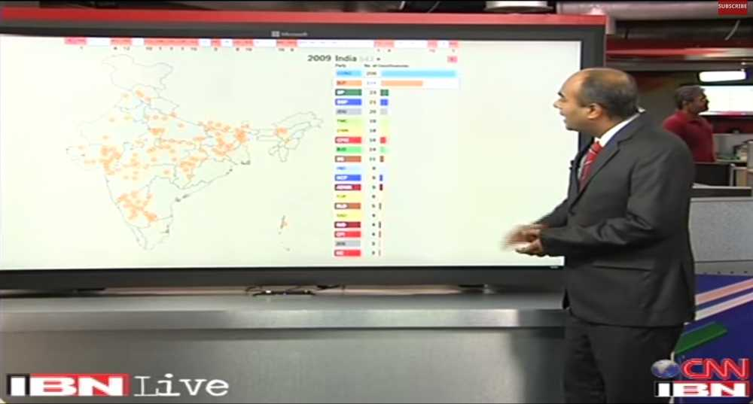
Gramener and CNN-IBN covered the 2014
General Elections
3 m
video
19 m
video

Slide 5
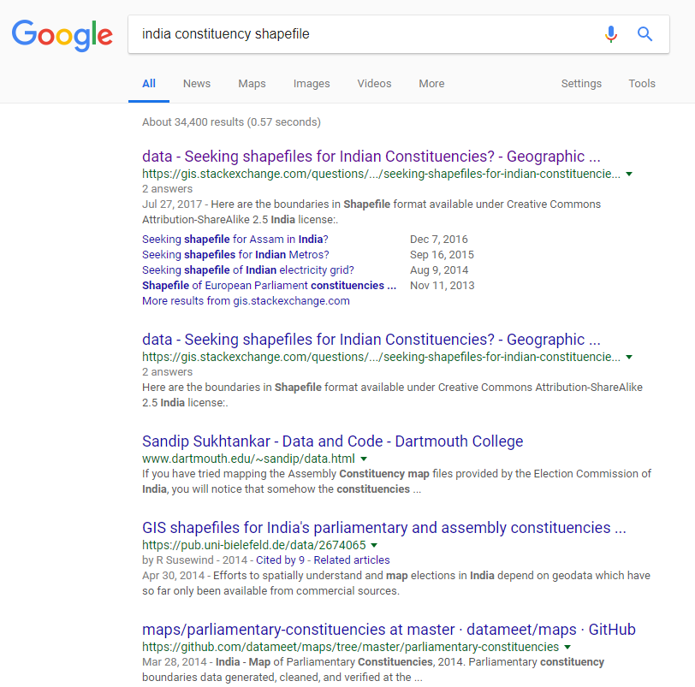
No official political boundaries as Shapefiles

Slide 6
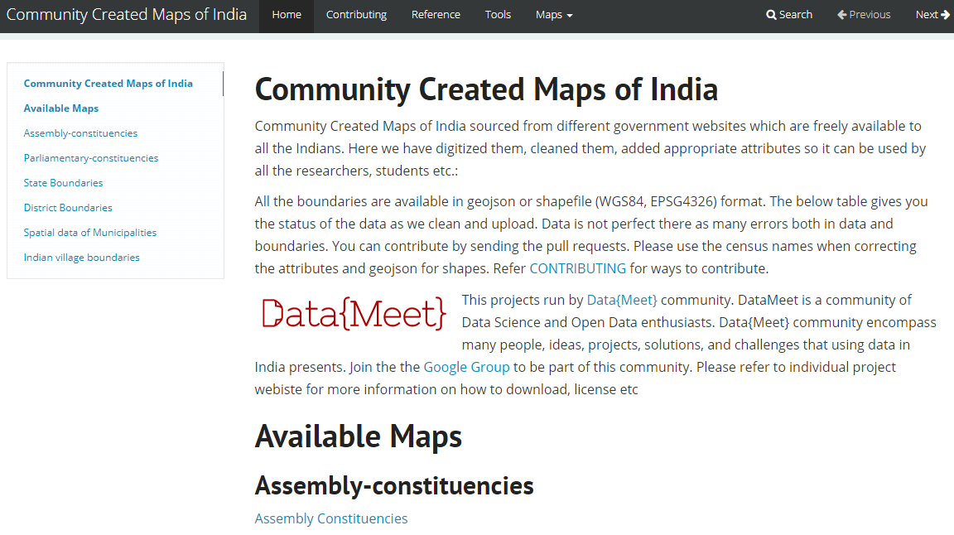
Creating Shapefiles from the PDF was largely manual
Link
PDF
SHP
SVG
Inkscape
QGIS

Slide 7
Election Choropleth
In the 2004 election to Lok Sabha there were 1,351 candidates from 6 National parties, 801 candidates from 36 State parties, 898 from recognized parties and 2385 independents.
The Congress (INC) won 145 seats in the 2004 elections. BJP won 138, coming a close second.
The constituencies where each party won is shown here. This visualization is called a choropleth.
Note that it appears that the BJP has won. (It did not.)
Maps
Platform
Visualization
Media

Slide 8
Election Cartogram
A re-rendering of the 2004 election results as a cartogram solves this problem.
Each circle represents one constituency. The size of the circle represents the number of voters. The color indicates the party that won.
This lets us represent 2 variables: size and color.
On this diagram, it is clearer to see that the results were close. The Congress (INC) won 145 seats in the 2004 elections. BJP won 138, coming a close second.
This solved another problem. We didn’t even have paper maps of historical constituencies.
Media

Slide 9
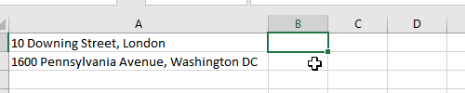

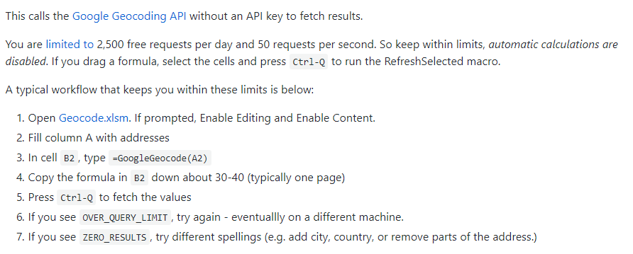
To locate old constituencies, we geo-coded in Excel
Link
https://github.com/sanand0/geocode-excel

Slide 10
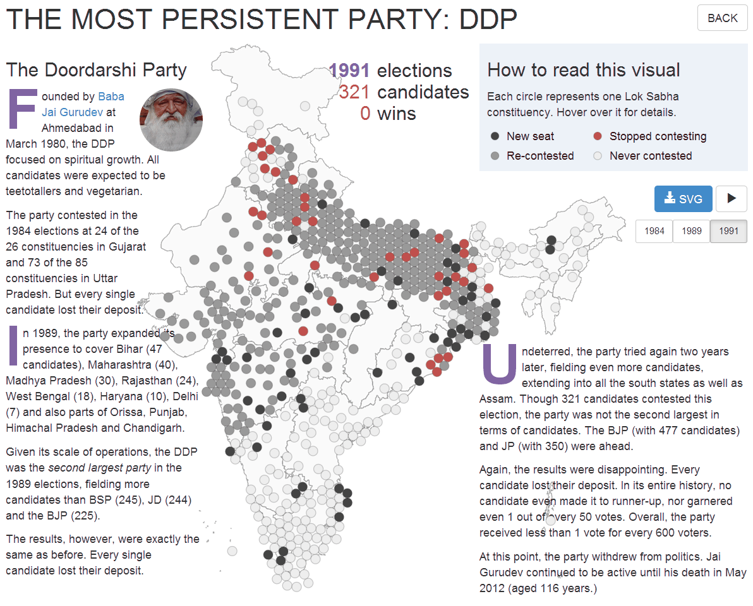
Which is the least successful party?
Link
Continued…
Media

Slide 11
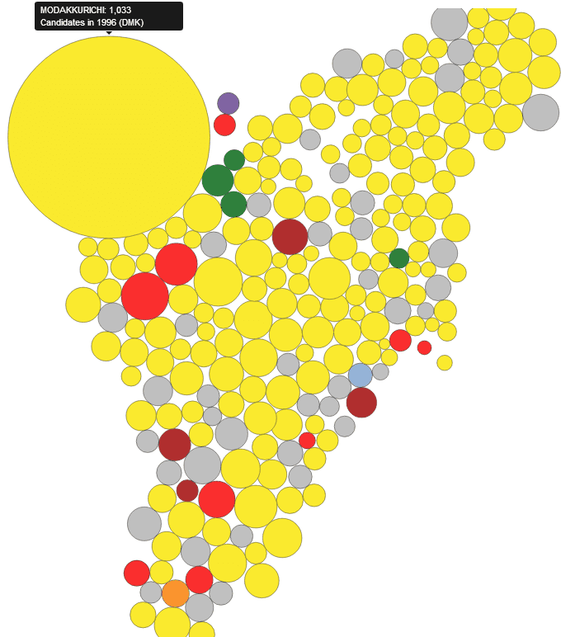
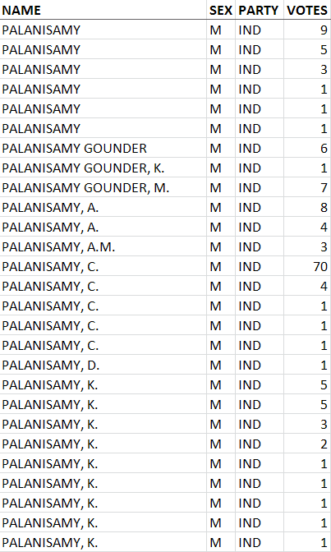
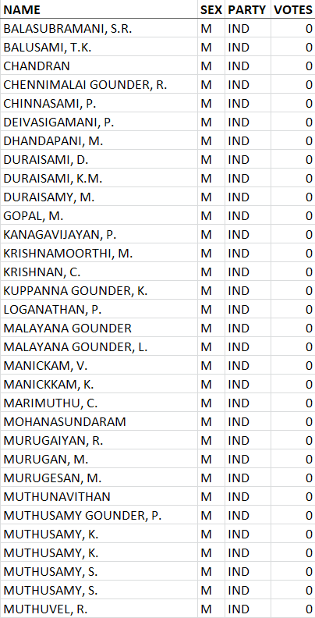
Where did the most number of candidates contest?
Link
Continued…
Media

Slide 12
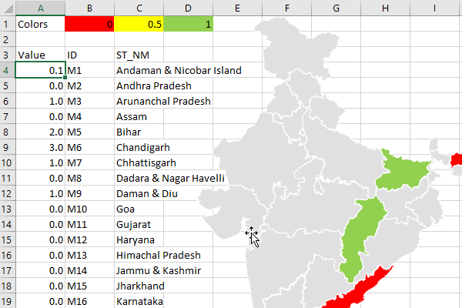
This tooling of Excel maps extended to choropleths too
Link
Open source tool to convert any shape file into an map directly editable in Excel
Shapes can be
natively edited
Used by major print & online publications such as The Hindu, The Times of India, Mint, Hindustan Times, India Today, Republic, Economic & Political Weekly, etc.
Maps
Microsoft

Slide 13
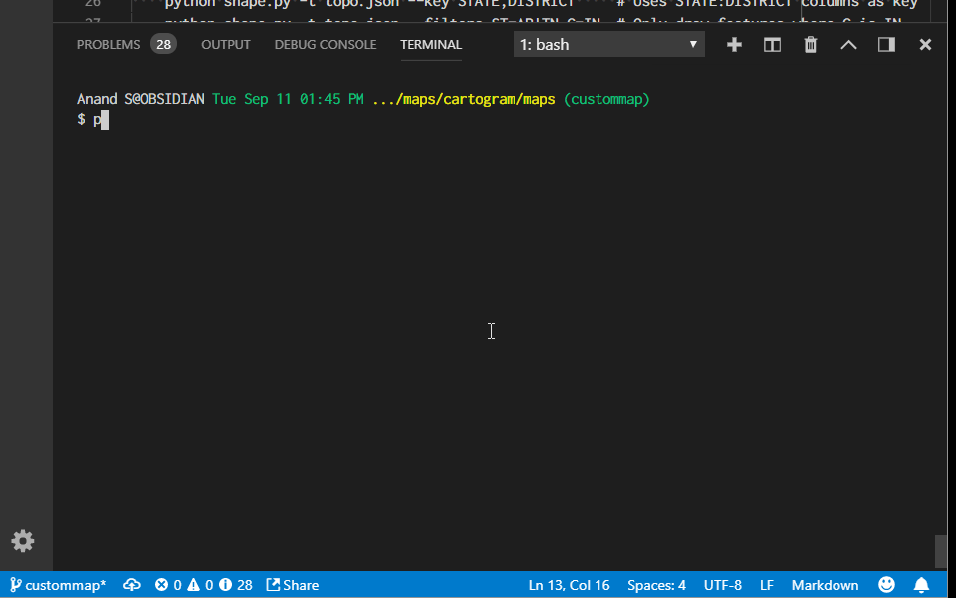
Let’s build a choropleth in Excel
Link

Slide 14
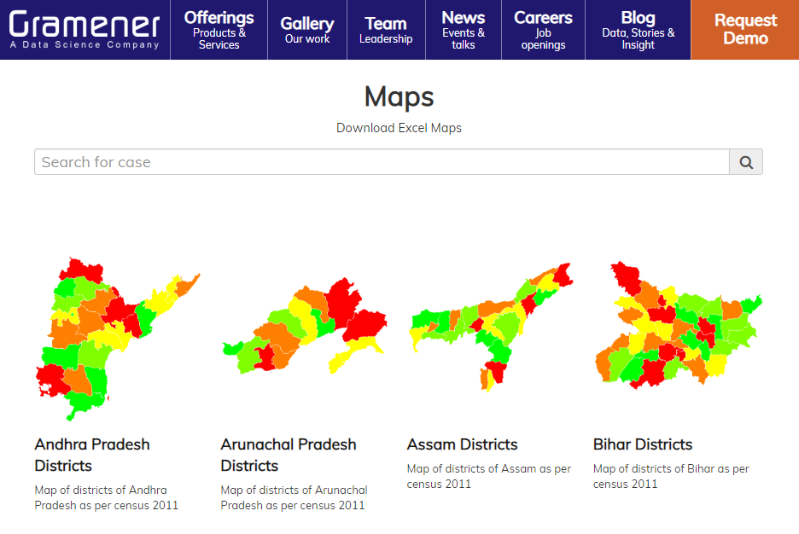
Download India maps from Gramener.com/map/
Link

Slide 15
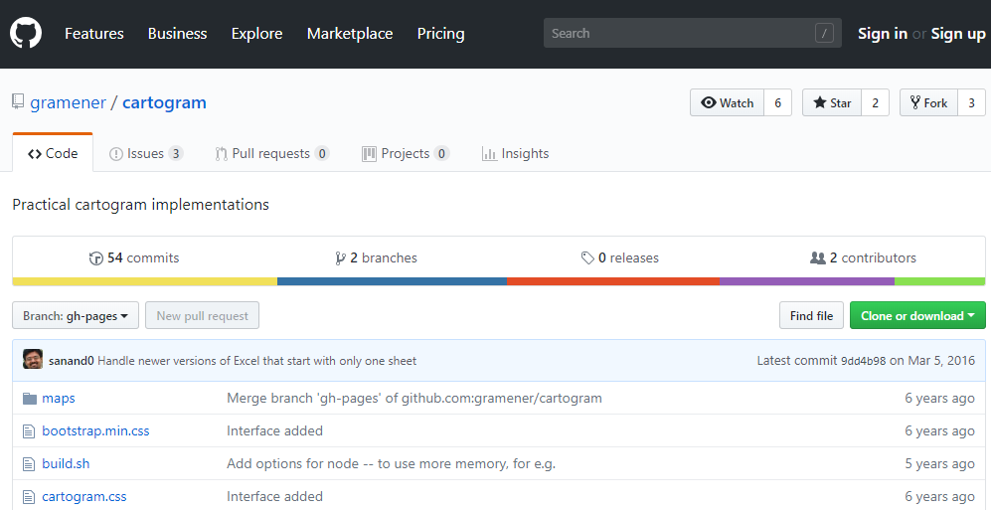
Make your own Excel maps from Shapefiles
Link
https://github.com/gramener/cartogram
python shape.py –t maps/S22_PC.json --view

Slide 16
Polling percentage
This is an example of how the Excel sheet was used by media.
The visual alongside shows the polling percentage (% of people that voted) – and clearly brought out the region that had much lower voter participation.

Slide 17
Postal code boundaries were an even larger headache
Political Boundaries
Postal Code Boundaries
Administrative Boundaries
State
Zone
State
Parliamentary constituency
Sorting District
District
Assembly constituency
Post office
Sub-District
Municipality
Polling booth
PIN Code
Block
Zone
Village
Ward
There are no maps of PIN codes. At all. Anywhere. In any form.

Slide 18
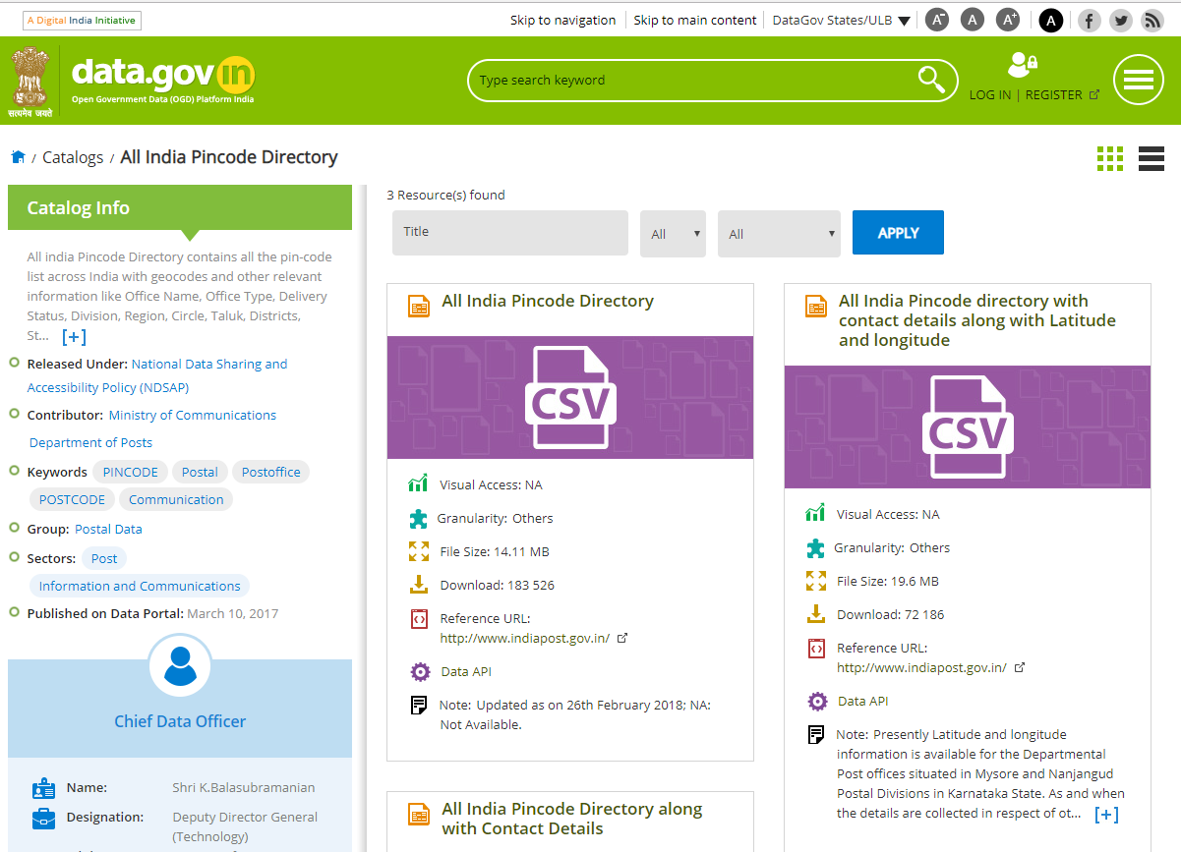
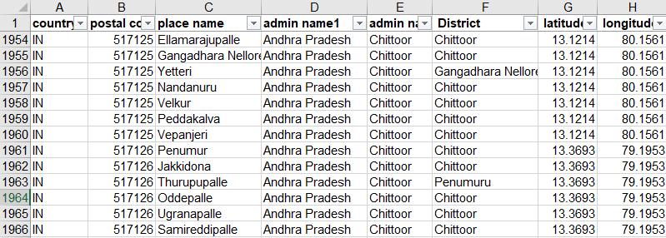
Link
After 4 years of extensive effort, PIN code locations were released

Slide 19
We still don’t have shapes. Need to create them from points
However… the official route is never as easy

Slide 20
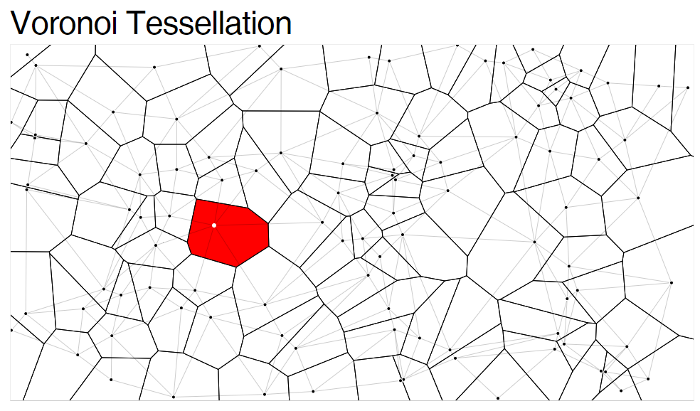
We still don’t have shapes. Need to create them from points
Link

Slide 21
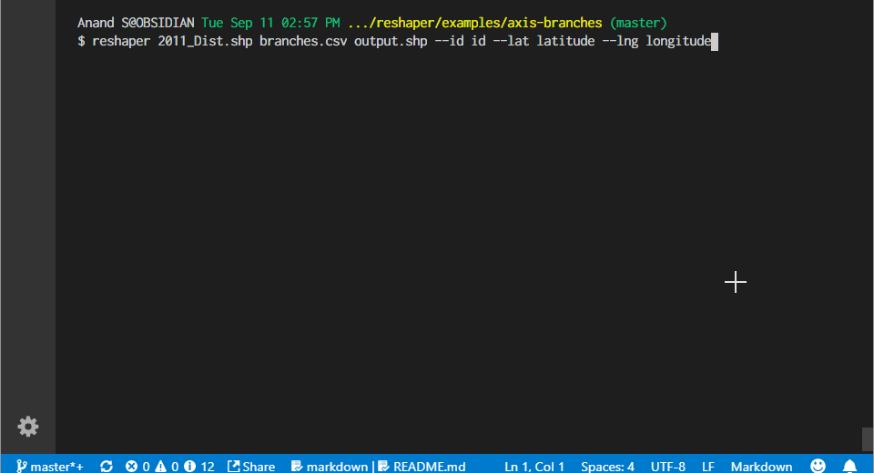
Reshaper recasts shapes based on locations
Link
https://github.com/gramener/reshaper

Slide 22
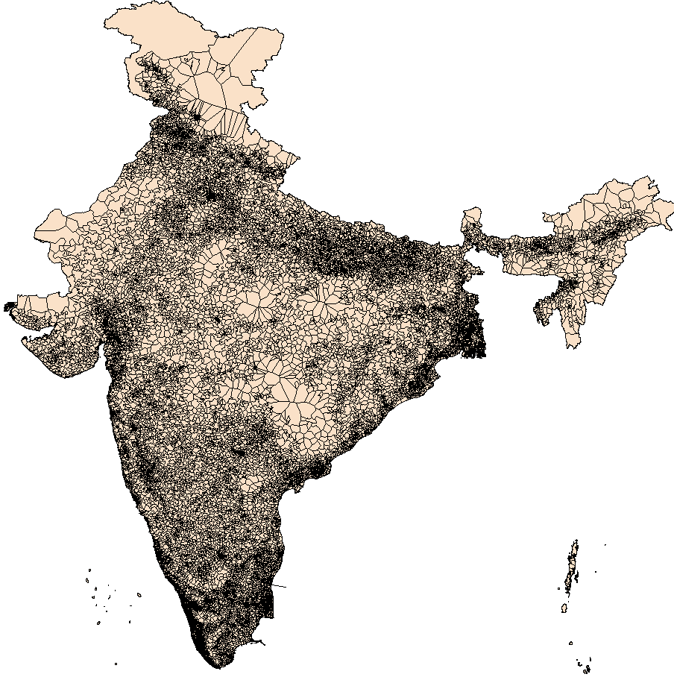
The PIN code shape file for India, finally

Slide 23
Let’s talk about Administrative Boundaries
Political Boundaries
Postal Code Boundaries
Administrative Boundaries
State
Zone
State
Parliamentary constituency
Sorting District
District
Assembly constituency
Post office
Sub-District
Municipality
Polling booth
PIN Code
Block
Zone
Village
Ward
These maps actually exist, but ownership (who maintains these) and distribution (getting these maps) is a problem

Slide 24
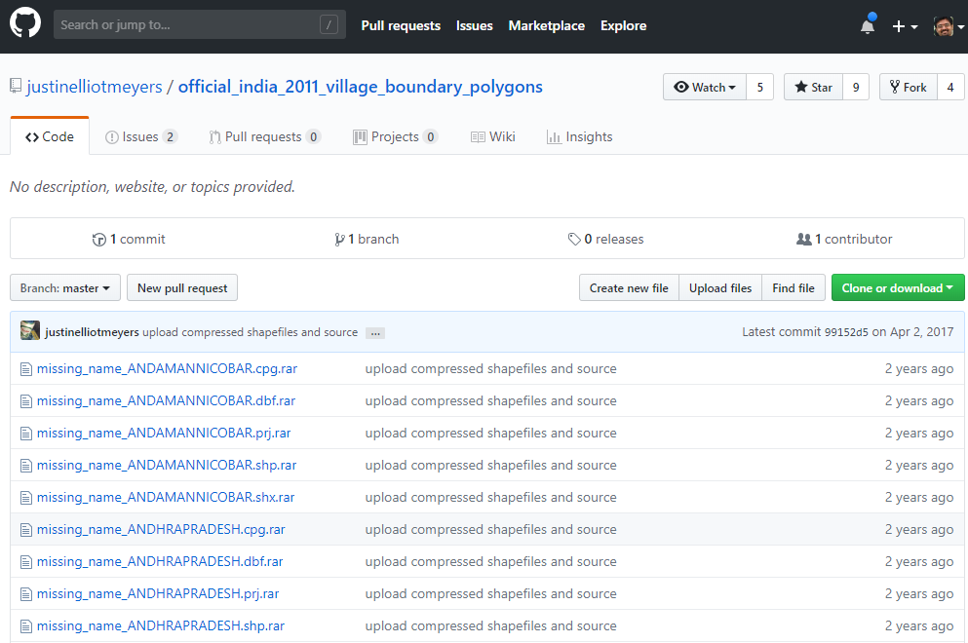
The work on village shapefiles is still on-going
Link

Slide 25
Here’s what you should take away
There are no official shapefiles in India
This led to simple GIS tools that you can use
The community needs help. You can pitch in
Search for
“Datameet maps”
or“Gramener maps”
for the next best thing
Visit the slide links
to download them.
They’re open source.
Search for “Datameet” and join the group.
Technology help is welcome.
GIS can be made much simpler than it often is

Slide 26
Happy mapping!
Any questions?

